Slide 1

Chapter 6: Bottom-Up Parsing (Shift-Reduce)
陳奇業 成功大學資訊工程系

Slide 2
Overview
We study bottom-up (also called LR) parsers, whose operation can be compared with top-down parsers as follows:
A bottom-up parser begins with the parse tree’s leaves and moves toward its root. A top-down parser moves the parse tree’s root toward its leaves.
A bottom-up parser traces a rightmost derivation in reverse. A top-down parser traces a leftmost derivation.
A bottom-up parser uses a grammar rule to replace the rule’s right-hand side (RHS) with its left-hand side (LHS). A top-down parser does the opposite, replacing a rule’s LHS with its RHS.

Slide 3
$$E→T→T∗F→T∗id→F∗id→id∗id$$

Slide 4

An Example
Grammar :
$S → aABe$
$A → Abc | b$
$B → d$
Input: $w = abbcde$
$S ⟹_{rm}aABe⟹_{rm}aAde⟹_{rm}aAbcde⟹_{rm}abbcde$ ( rightmost derivation )
LR parsing:
$abbcde⟹aAbcde⟹aAde⟹aABe⟹S$ ( rightmost derivation in reverse)

Slide 5
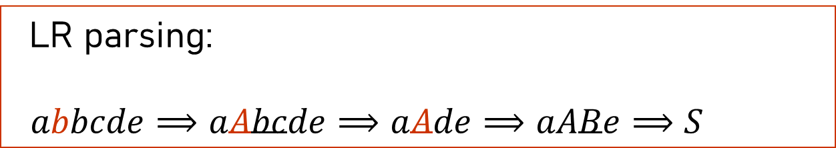
S
1
a
A
B
e
2
3
A
b
c
d
4
b
LR parsing:
$abbcde⟹aAbcde⟹aAde⟹aABe⟹S$

Slide 6
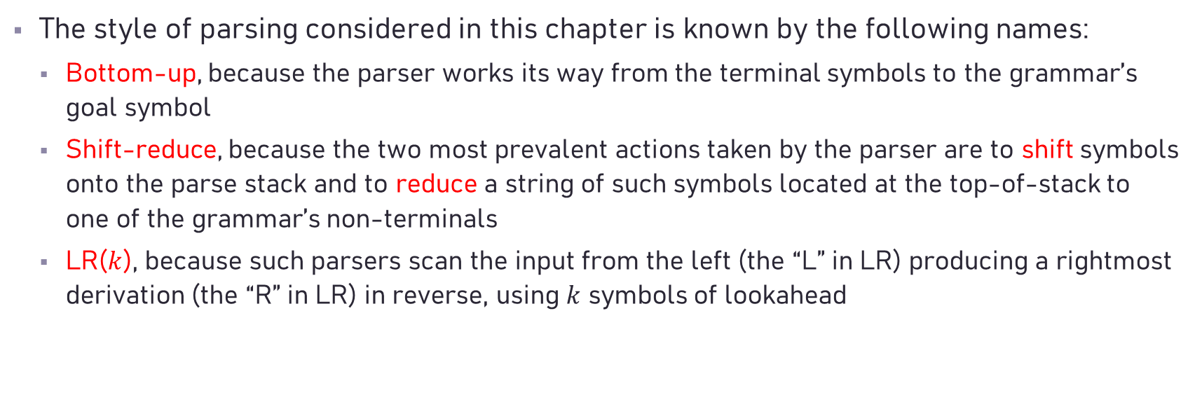
Overview
The style of parsing considered in this chapter is known by the following names:
Bottom-up, because the parser works its way from the terminal symbols to the grammar’s goal symbol
Shift-reduce, because the two most prevalent actions taken by the parser are to shift symbols onto the parse stack and to reduce a string of such symbols located at the top-of-stack to one of the grammar’s non-terminals
LR($k$), because such parsers scan the input from the left (the “L” in LR) producing a rightmost derivation (the “R” in LR) in reverse, using $k$ symbols of lookahead

Slide 7
Handle Pruning
Bottom-up parsing during a left-to-right scan of the input constructs a rightmost derivation in reverse.
Informally, a "handle" is a substring that matches the body of a production, and whose reduction represents one step along the reverse of a rightmost derivation.
Given a sentential form, the handle is defined as the sequence of symbols that will next be replaced by reduction.

Slide 8
Example

Slide 9
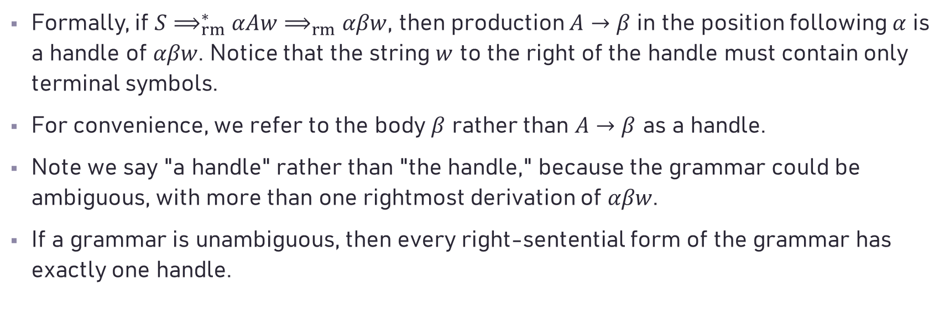
Handle Pruning
Formally, if $S⟹_{rm}^{∗}αAw⟹_{rm}αβw$, then production $A→β$ in the position following $α$ is a handle of $αβw$. Notice that the string $w$ to the right of the handle must contain only terminal symbols.
For convenience, we refer to the body $β$ rather than $A→β$ as a handle.
Note we say "a handle" rather than "the handle," because the grammar could be ambiguous, with more than one rightmost derivation of $αβw$.
If a grammar is unambiguous, then every right-sentential form of the grammar has exactly one handle.

Slide 10

Handle Pruning
A rightmost derivation in reverse can be obtained by "handle pruning.“ That is, we start with a string of terminals $w$ to be parsed. If $w$ is a sentence of the grammar at hand, then let $w=γ_{n}$, where $γ_{n}$ is the $n$th right-sentential form of some as yet unknown rightmost derivation
$$S=γ_{0}⟹_{rm}γ_{1}⟹_{rm}γ_{2}⋯⟹_{rm}γ_{n−1}⟹_{rm}γ_{n}=w$$

Slide 11
Shift-Reduce Parsing
There are four actions a parser can make:
Shift. Shift the next input symbol onto the top of the stack.
Reduce. The right end of the string to be reduced must be at the top of the stack. Locate the left end of the string within the stack and decide with what nonterminal to replace the string.
Accept. Announce successful completion of parsing.
Error. Discover a syntax error and call an error recovery routine.

Slide 12
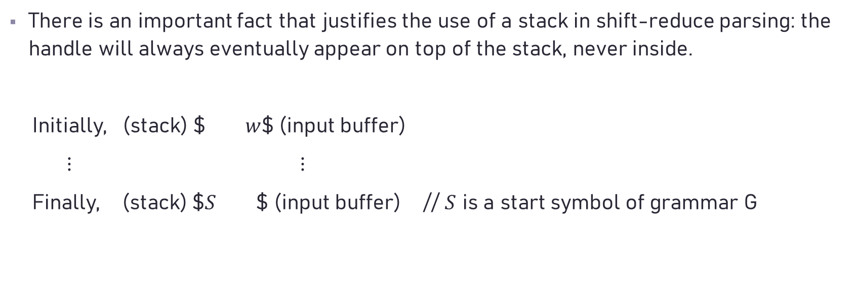
Stack Implementation of Bottom-Up Parsing
There is an important fact that justifies the use of a stack in shift-reduce parsing: the handle will always eventually appear on top of the stack, never inside.
Initially, (stack) $ $w$$ (input buffer)
$⋮$ $⋮$
Finally, (stack) $$S$ $ (input buffer) // $S$ is a start symbol of grammar G

Slide 13
Example (from 龍書)

Slide 15
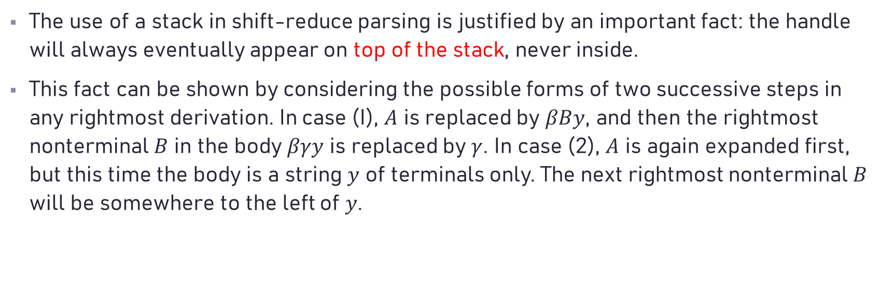
Shift-Reduce Parsing
The use of a stack in shift-reduce parsing is justified by an important fact: the handle will always eventually appear on top of the stack, never inside.
This fact can be shown by considering the possible forms of two successive steps in any rightmost derivation. In case (I), $A$ is replaced by $βBy$, and then the rightmost nonterminal $B$ in the body $βγy$ is replaced by $γ$. In case (2), $A$ is again expanded first, but this time the body is a string $y$ of terminals only. The next rightmost nonterminal $B$ will be somewhere to the left of $y$.

Slide 16
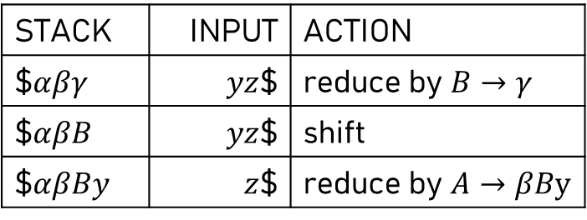

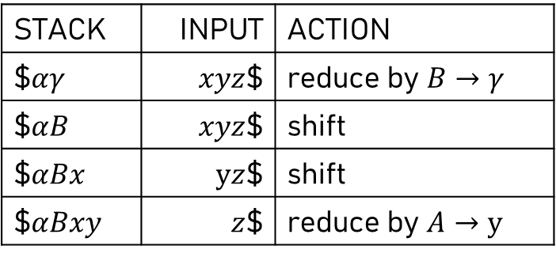
Shift-Reduce Parsing
In other words:
(1) $S⟹_{rm}^{∗}αAz⟹_{rm}αβByz⟹_{rm}αβγyz$
(2) $S⟹_{rm}^{∗}αBxAz⟹_{rm}αBxyz⟹_{rm}αγxyz$
Consider case (1) in reverse Consider case (2)
STACK | INPUT | ACTION
$$αβγ$ | $yz$$ | reduce by $B→γ$
$$αβB$ | $yz$$ | shift
$$αβBy$ | $z$$ | reduce by $A→βBy$
STACK | INPUT | ACTION
$$αγ$ | $xyz$$ | reduce by $B→γ$
$$αB$ | $xyz$$ | shift
$$αBx$ | $yz$$ | shift
$$αBxy$ | $z$$ | reduce by $A→y$

Slide 17
LR Parsers
Advantages:
LR parsers can be constructed to recognize all programming language construct for which context-free grammars can be written.
The LR-parsing method is the most general nonbacktracking shift-reduce parsing method known, yet it can be implemented as efficiently as other, more primitive shift-reduce methods
The class of grammars that can be parsed by LR parser is the proper superset of the class of grammars that can be parsed by predictive parsers.
LR parsers can detect errors in syntax as soon as possible
Drawbacks:
Too much work to do

Slide 18
LR Parsing Engine

Slide 19
LR Parsing Engine

Slide 20
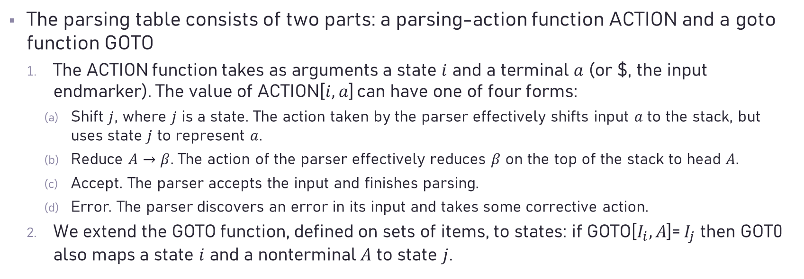
Structure of the LR Parsing Table
The parsing table consists of two parts: a parsing-action function ACTION and a goto function GOTO
The ACTION function takes as arguments a state $i$ and a terminal $a$ (or $, the input endmarker). The value of ACTION[$i, a$] can have one of four forms:
Shift $j$, where $j$ is a state. The action taken by the parser effectively shifts input $a$ to the stack, but uses state $j$ to represent $a$.
Reduce $A→β$. The action of the parser effectively reduces $β$ on the top of the stack to head $A$.
Accept. The parser accepts the input and finishes parsing.
Error. The parser discovers an error in its input and takes some corrective action.
We extend the GOTO function, defined on sets of items, to states: if GOTO[$I_{i}, A$]= $I_{j}$ then GOT0 also maps a state $i$ and a nonterminal $A$ to state $j$.

Slide 24
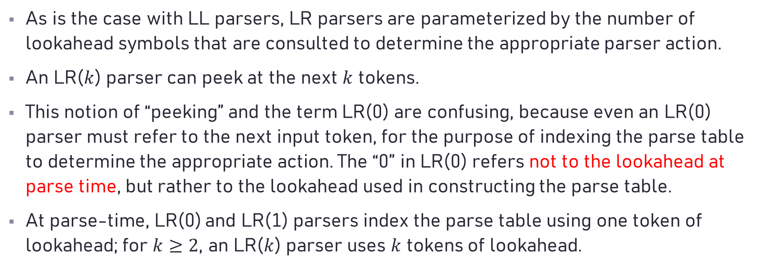
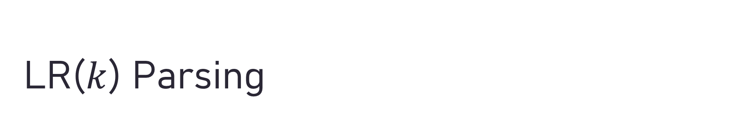
LR($k$) Parsing
As is the case with LL parsers, LR parsers are parameterized by the number of lookahead symbols that are consulted to determine the appropriate parser action.
An LR($k$) parser can peek at the next $k$ tokens.
This notion of “peeking” and the term LR(0) are confusing, because even an LR(0) parser must refer to the next input token, for the purpose of indexing the parse table to determine the appropriate action. The “0” in LR(0) refers not to the lookahead at parse time, but rather to the lookahead used in constructing the parse table.
At parse-time, LR(0) and LR(1) parsers index the parse table using one token of lookahead; for $k≥2$, an LR($k$) parser uses $k$ tokens of lookahead.

Slide 25
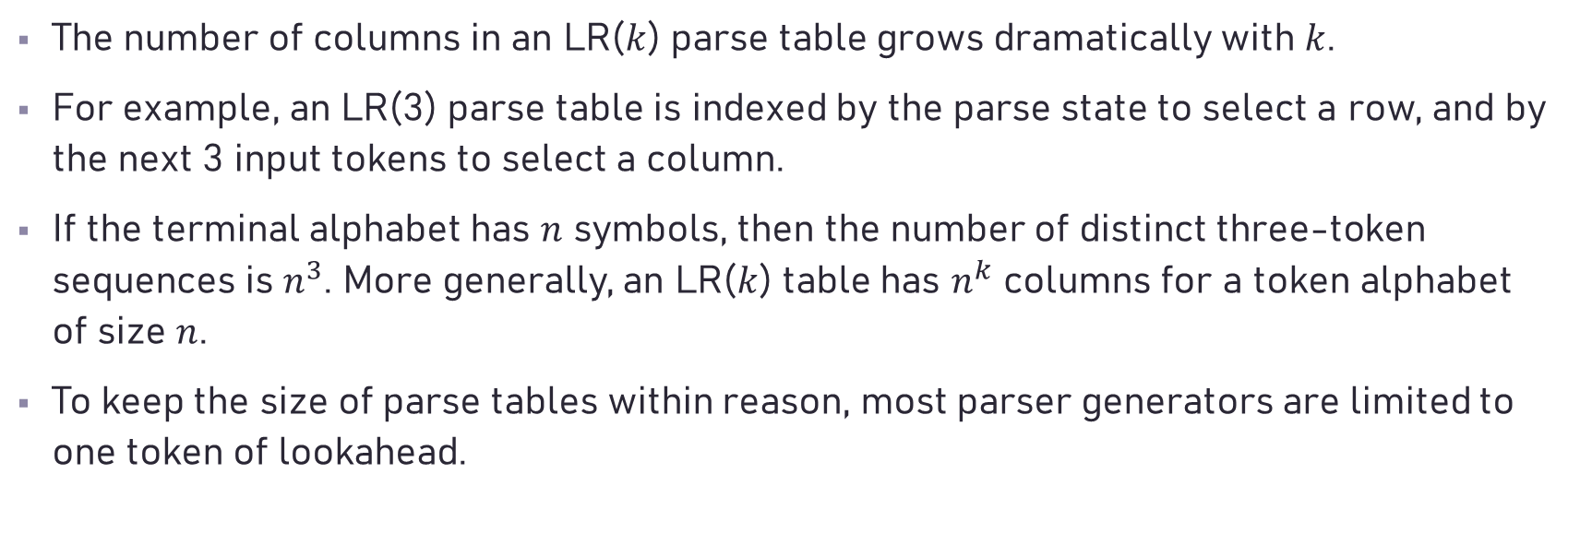
LR($k$) Parsing
The number of columns in an LR($k$) parse table grows dramatically with $k$.
For example, an LR(3) parse table is indexed by the parse state to select a row, and by the next 3 input tokens to select a column.
If the terminal alphabet has $n$ symbols, then the number of distinct three-token sequences is $n^{3}$. More generally, an LR($k$) table has $n^{k}$ columns for a token alphabet of size $n$.
To keep the size of parse tables within reason, most parser generators are limited to one token of lookahead.

Slide 26
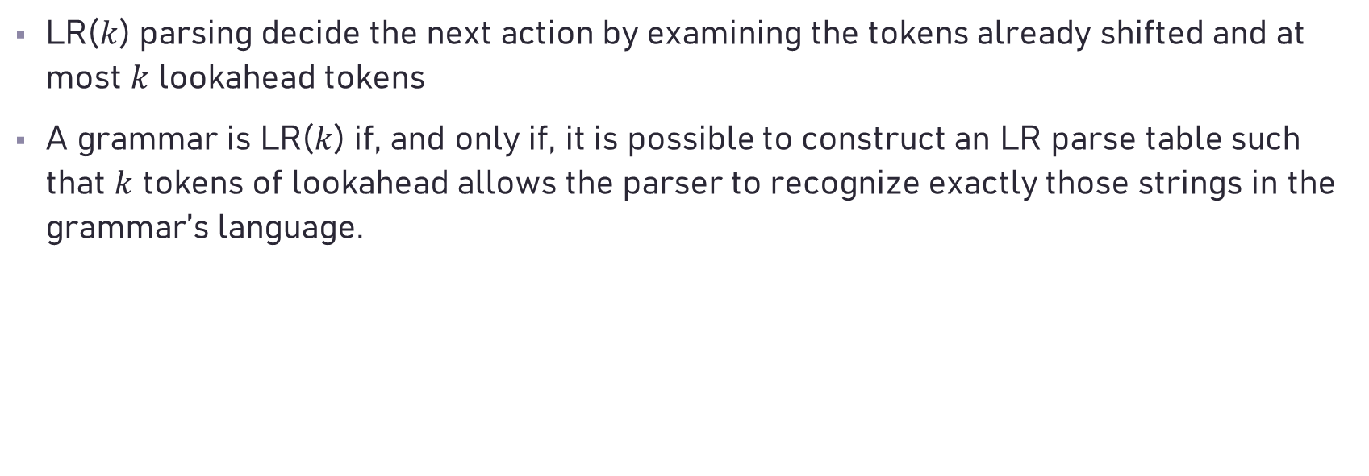
LR($k$) Parsing
LR($k$) parsing decide the next action by examining the tokens already shifted and at most $k$ lookahead tokens
A grammar is LR($k$) if, and only if, it is possible to construct an LR parse table such that $k$ tokens of lookahead allows the parser to recognize exactly those strings in the grammar’s language.

Slide 27
LR(0) Table Construction
To keep track of the parser’s progress, we introduce the notion of an LR(0) item—a grammar production with a bookmark that indicates the current progress through the production’s RHS.

Slide 28
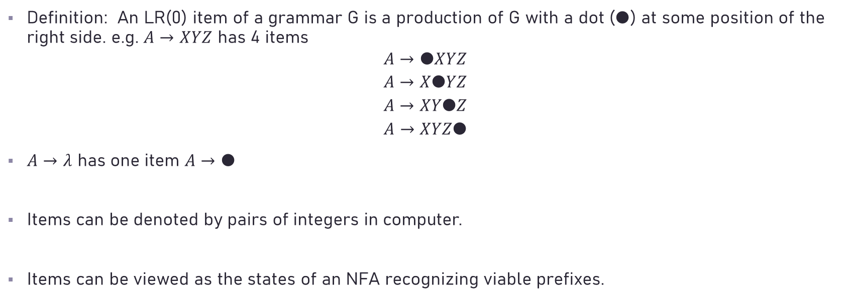
LR(0) Table Construction
Definition: An LR(0) item of a grammar G is a production of G with a dot ($●$) at some position of the right side. e.g. $A→XYZ$ has 4 items
$$A→●XYZ$$
$$A→X●YZ$$
$$A→XY●Z$$
$$A→XYZ●$$
$A→λ$ has one item $A→●$
Items can be denoted by pairs of integers in computer.
Items can be viewed as the states of an NFA recognizing viable prefixes.

Slide 29
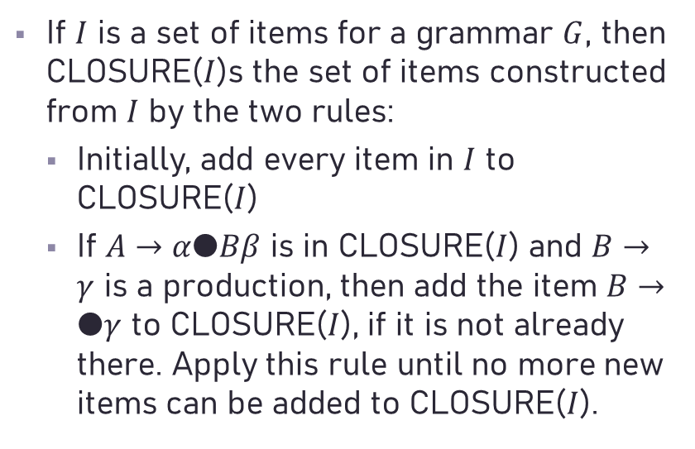
Closure of Item Sets
If $I$ is a set of items for a grammar $G$, then CLOSURE($I$)s the set of items constructed from $I$ by the two rules:
Initially, add every item in $I$ to CLOSURE($I$)
If $A→α●Bβ$ is in CLOSURE($I$) and $B→γ$ is a production, then add the item $B→●γ$ to CLOSURE($I$), if it is not already there. Apply this rule until no more new items can be added to CLOSURE($I$).

Slide 30
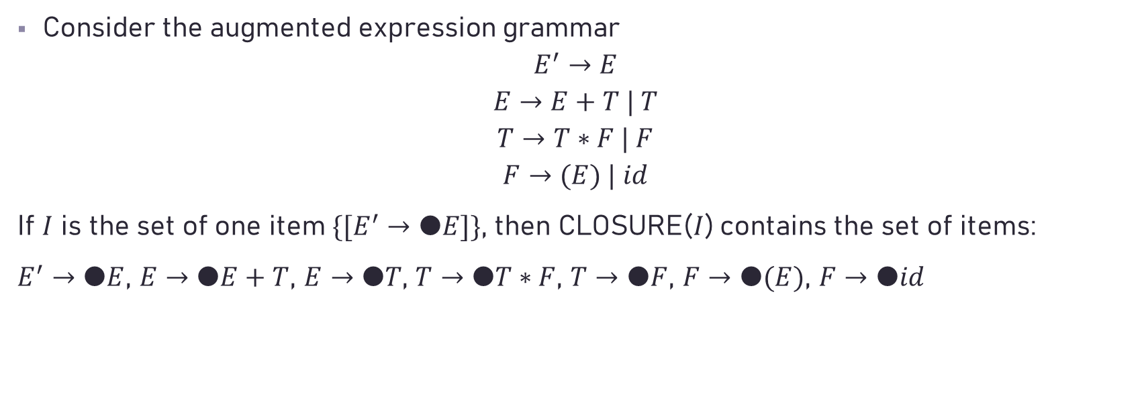
Example
Consider the augmented expression grammar
$$E^{′}→E$$
$$E→E+T | T$$
$$T→T∗F | F$$
$$F→(E) | id$$
If $I$ is the set of one item $\{[E^{′}→●E]\}$, then CLOSURE($I$) contains the set of items:
$E^{′}→●E$, $E→●E+T$, $E→●T$, $T→●T∗F$, $T→●F$, $F→●(E)$, $F→●id$

Slide 31
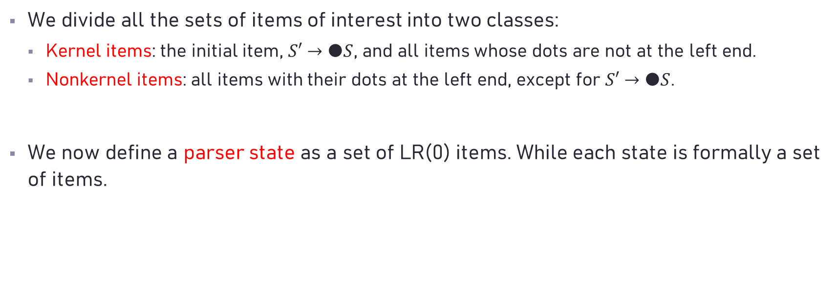
LR(0) items
We divide all the sets of items of interest into two classes:
Kernel items: the initial item, $S′→●S$, and all items whose dots are not at the left end.
Nonkernel items: all items with their dots at the left end, except for $S′→●S$.
We now define a parser state as a set of LR(0) items. While each state is formally a set of items.

Slide 32
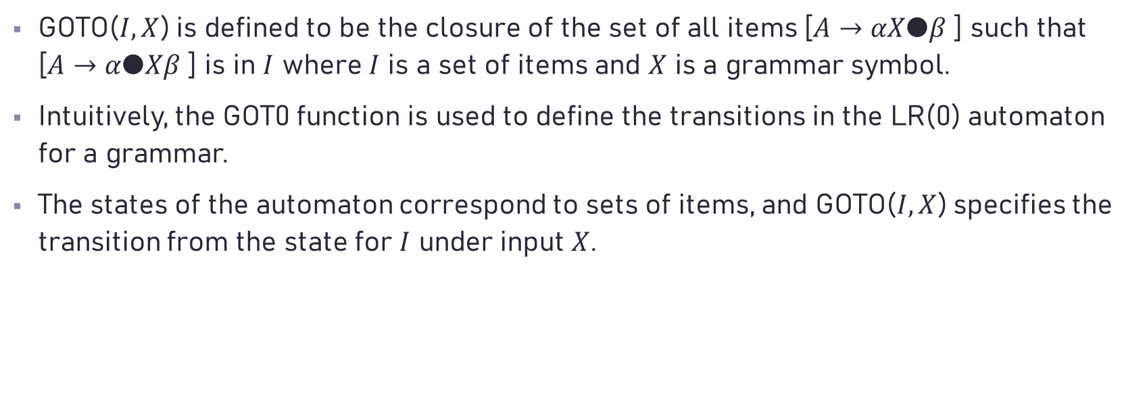
The Function GOT0
GOTO($I, X$) is defined to be the closure of the set of all items [$A→αX●β$ ] such that [$A→α●Xβ$ ] is in $I$ where $I$ is a set of items and $X$ is a grammar symbol.
Intuitively, the GOT0 function is used to define the transitions in the LR(0) automaton for a grammar.
The states of the automaton correspond to sets of items, and GOTO($I, X$) specifies the transition from the state for $I$ under input $X$.

Slide 36
Characteristic Finite-State Machine (CFSM)
The basis for LR parsing is a deterministic finite automaton (DFA), called the characteristic finite-state machine (CFSM).
A viable prefix of a right sentential form is any prefix that does not extend beyond its handle.
Formally, a CFSM recognizes its grammar’s viable prefixes.
When the automaton arrives in a double-boxed state, it has processed a viable prefix that ends with a handle.

Slide 37
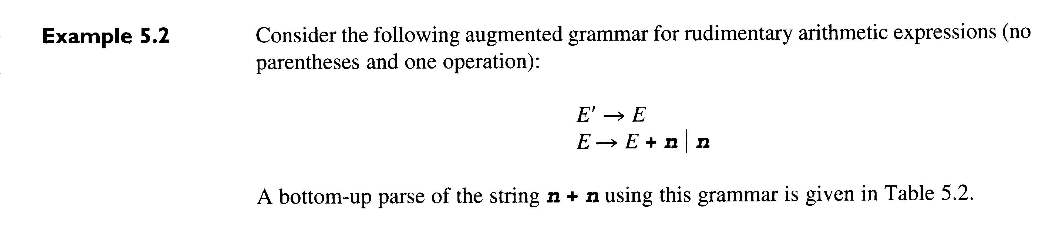
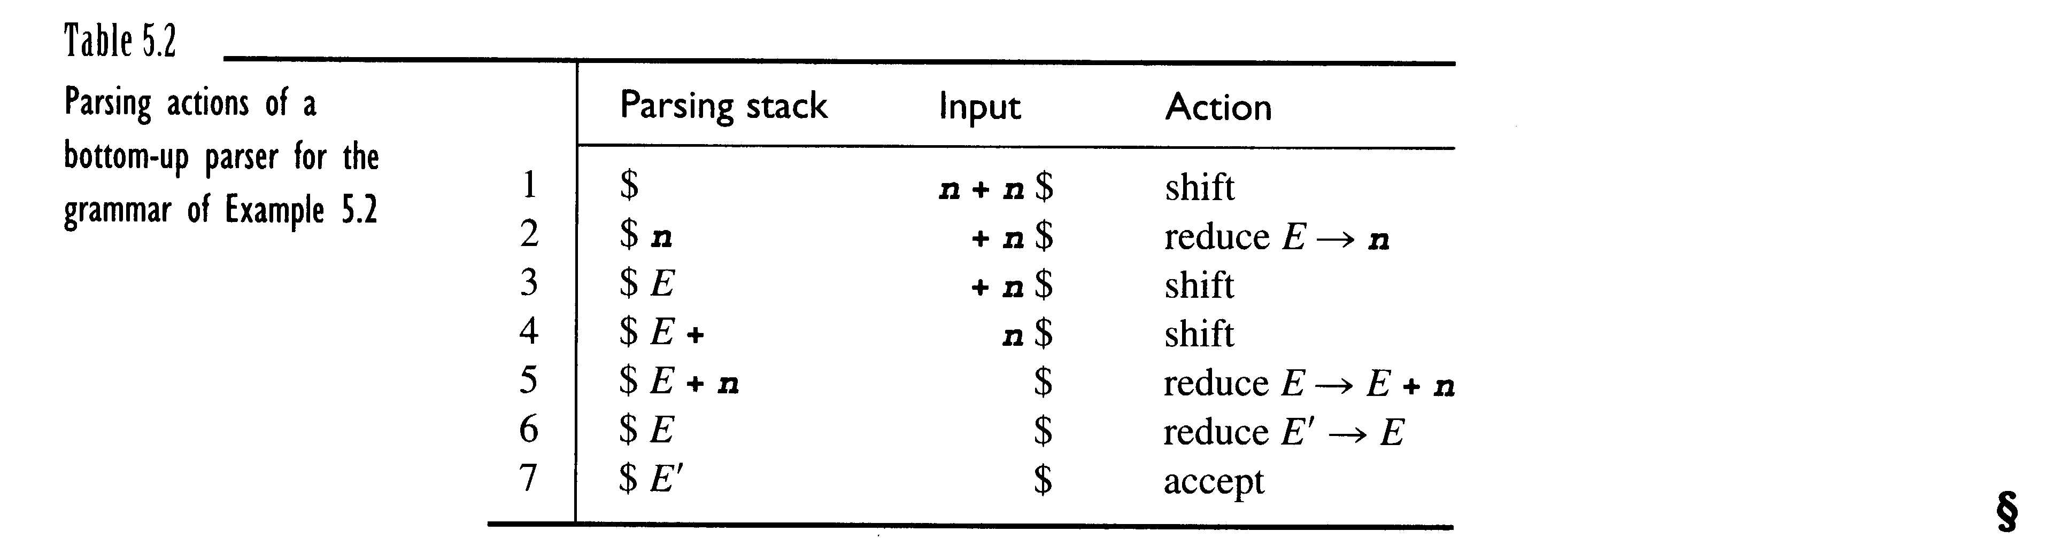

$$E’⟹E⟹E + n⟹n + n$$
$E, E+, E+n$are all viable prefixes of the right-sentential form $E+n$.

Slide 38
Completing an LR(0) Parse Table

Slide 39
LR(0) Parse (from 龍書)

Slide 40
LR(0) Parse (from 龍書)

Slide 41
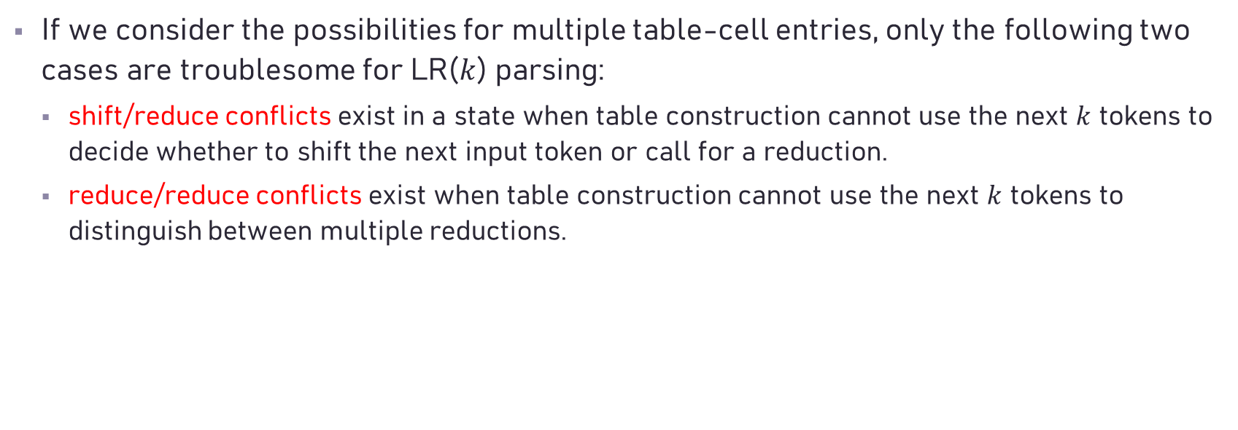
Conflict Diagnosis
If we consider the possibilities for multiple table-cell entries, only the following two cases are troublesome for LR($k$) parsing:
shift/reduce conflicts exist in a state when table construction cannot use the next $k$ tokens to decide whether to shift the next input token or call for a reduction.
reduce/reduce conflicts exist when table construction cannot use the next $k$ tokens to distinguish between multiple reductions.

Slide 42
Conflict Diagnosis
Conflicts arise for one of the following reasons:
The grammar is ambiguous. No (deterministic) table-construction method can resolve conflicts that arise due to ambiguity.
The grammar is not ambiguous, but the current table-building approach could not resolve the conflict. In this case, the conflict might disappear if one or more of the following approaches is taken:
The current table-construction method is given more lookahead.
A more powerful table-construction method is used.

Slide 43
Ambiguous Grammars

Slide 44
Ambiguous Grammars
The parse tree that favors the reduction in State 5 corresponds to a left-associative grouping for addition, while the shift corresponds to a right-associative grouping.

Slide 45
Ambiguous Grammars
Ambiguous
Unambiguous

Slide 46
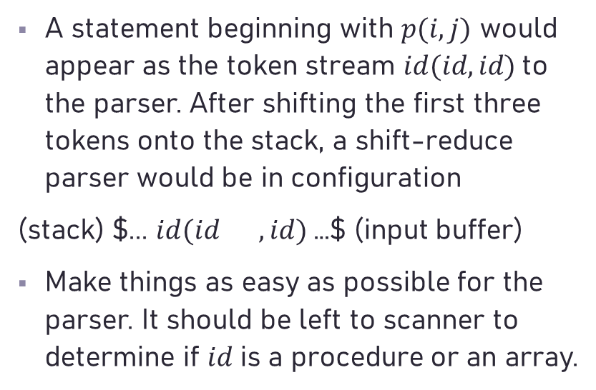
Ambiguous Grammars
A statement beginning with $p(i, j)$ would appear as the token stream $id(id, id)$to the parser. After shifting the first three tokens onto the stack, a shift-reduce parser would be in configuration
(stack) $... $id(id$ $, id)$…$ (input buffer)
Make things as easy as possible for the parser. It should be left to scanner to determine if 𝑖𝑑 is a procedure or an array.
array
procedure

Slide 47
Grammars that are not LR(k)
must know the last character of input

Slide 48
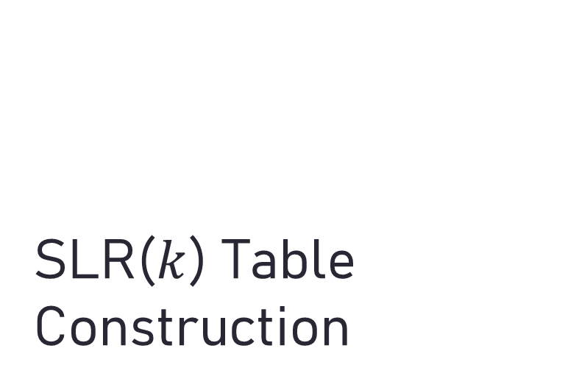
SLR($k$) Table Construction
The SLR(k) (Simple LR with k tokens of lookahead) method attempts to resolve inadequate states using grammar analysis methods.
this grammar is LR(0)

Slide 49
SLR($k$) Table Construction

Slide 50
shift/reduce conflict
$⟶^{reduce}E⟶^{shift}E times$ $⟶^{shift}$ $E times num$
Error!!
shift/reduce conflict

Slide 51
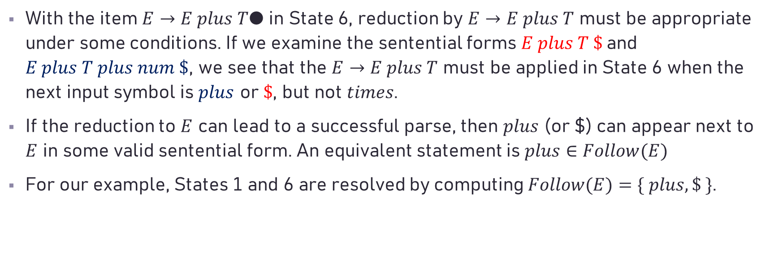
SLR(𝑘) Table Construction
With the item $E→E plus T●$ in State 6, reduction by $E→E plus T$ must be appropriate under some conditions. If we examine the sentential forms $E plus T \$$and $E plus T plus num \$$, we see that the $E→E plus T$ must be applied in State 6 when the next input symbol is $plus$ or $\$$, but not $times$.
If the reduction to $E$ can lead to a successful parse, then $plus$ (or $) can appear next to $E$ in some valid sentential form. An equivalent statement is $plus∈Follow(E)$
For our example, States 1 and 6 are resolved by computing $Follow(E)=\{ plus, \$ \}$.

Slide 52
SLR(𝑘) Table Construction

Slide 53
SLR(𝑘) Table Construction

Slide 54
Exercises 4, 5, 6, 10

